Slide 1
REAL TIME SYSTEM
(Communication Protocol)
By: Mohammad Aiman Naufal bin Abd Rahim

Slide 2
EXAMPLES (INTER)
02
OVERVIEW
TABLE OF CONTENTS
01
03
EXAMPLES (INTRA)

Slide 3
01
OVERVIEW

Slide 4
Protocol: A set of rules and regulations is called a protocol.
Communication: Exchange of information from one system to another system with a medium is called communication.
Communication Protocol: A set of rules and regulations that allow two electronic devices to connect to exchange the data with one and another.

Slide 5
TYPES OF COMMUNICATION PROTOCOLS
INTER SYSTEM PROTOCOL
INTRA SYSTEM PROTOCOL
To communicate between two different devices.
To communicate between two different devices within the circuit board.

Slide 6
02
EXAMPLES (INTER)

Slide 7
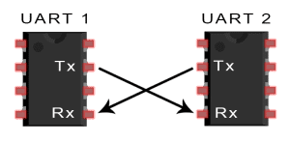
UART
Wires used: 2
Maximum speed: Up to 115200 baud
Type of synchronization: Asynchronous
Connection: Serial
Number of masters: 1
Number of slaves: 1

Slide 8
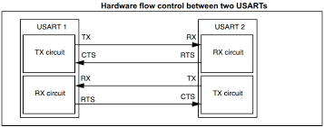
USART
Wires used: 2
Maximum speed: Up to 115200 baud
Type of synchronization: Asynchronous / Synchronous
Connection: Serial
Number of masters: 1
Number of slaves: 1

Slide 9
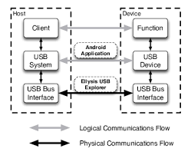
USB
A serial communication with two-wire protocol called D+ and D-.
Used to communicate with system peripheral.
Send and receive the data serially.
Has many different types of USB with different speed.

Slide 10
03
EXAMPLES (INTRA)

Slide 11
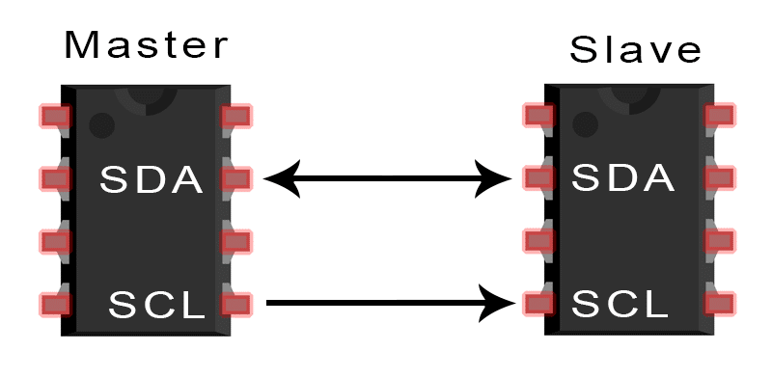
I2C
SDA : Serial Data
SCL : Serial Clock
Wires used: 2
Maximum speed: Up to 5Mbps
Type of synchronization: Synchronous
Connection: Serial
Number of masters: Unlimited
Number of slaves: Up to 1008

Slide 12
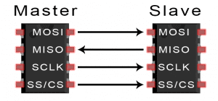
SPI
MOSI : Master Output / Slave Input
MISO : Master Input / Slave Output
SCLK : Serial Clock
SS/CS : Slave Select / Chip Select
Wires used: 4
Maximum speed: Up to 10Mbps
Type of synchronization: Synchronous
Connection: Serial
Number of masters: 1
Number of slaves: Unlimited

Slide 13
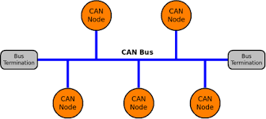
CAN
A serial communication with two-wire protocol called CAN High (H+) CAN Low (H-).
Full duplex control.
Multi master protocol.
Within two circuit boards.

Slide 14
THANKS

